Slide 1
Get them While They’re Young
Generations

Slide 2
What are the Generations?
The Greatest Generation - born 1901-1927
The Silent Generation - born 1928-1945
Baby Boomers - born 1946-1964
Generation X - born 1965-1980
Millennials - born 1981-1996
Generation Z - born 1997-2012
Generation Alpha - born 2013-2024
Generation Beta - born 2025-2039

Slide 3
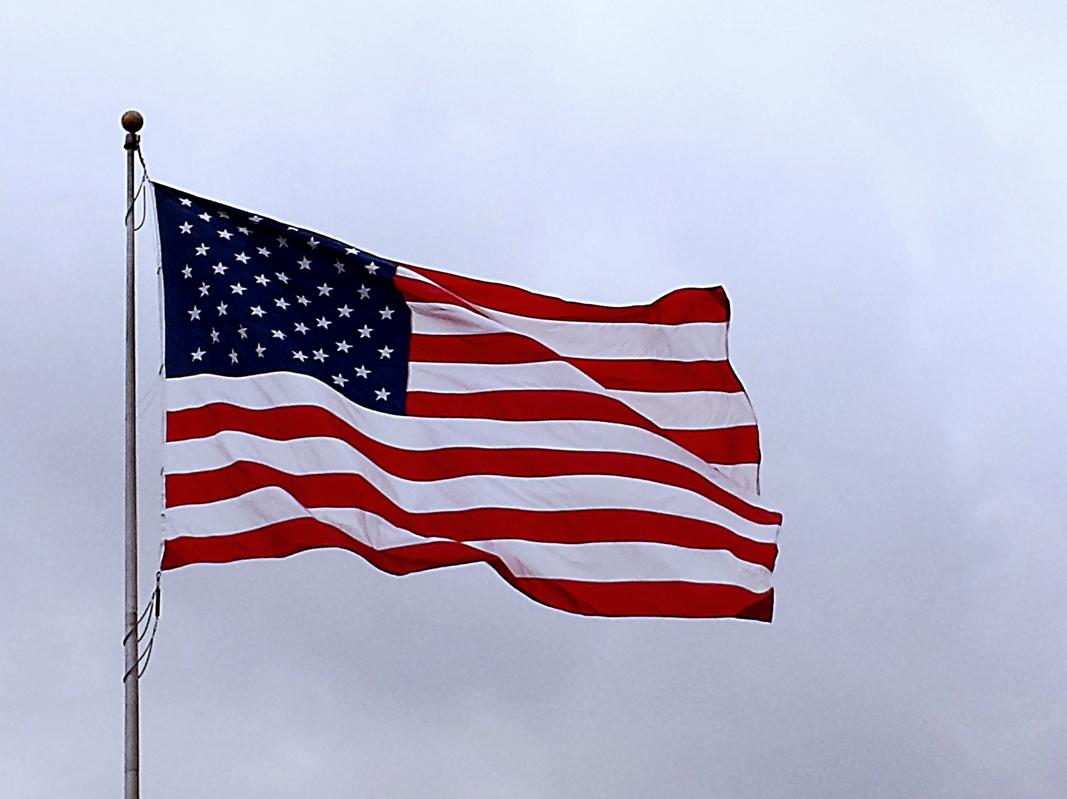
The Greatest Generation:
Born 1901-1927 (Age 98-124)
Experiencing the Great Depression
  Sense of frugality and resilience.
Impact of World War II
  demonstrating patriotism and a strong work ethic
Traditional values
Hard work, grit sacrifice and community service

Slide 4


The Silent Generation:
Born 1928–1945 (AGE 80-97)
Conformists
Silent during McCarthy Era of the 50
Peace after WW2
Fear of communism
VS
This Photo by Unknown Author is licensed under CC BY

Slide 5
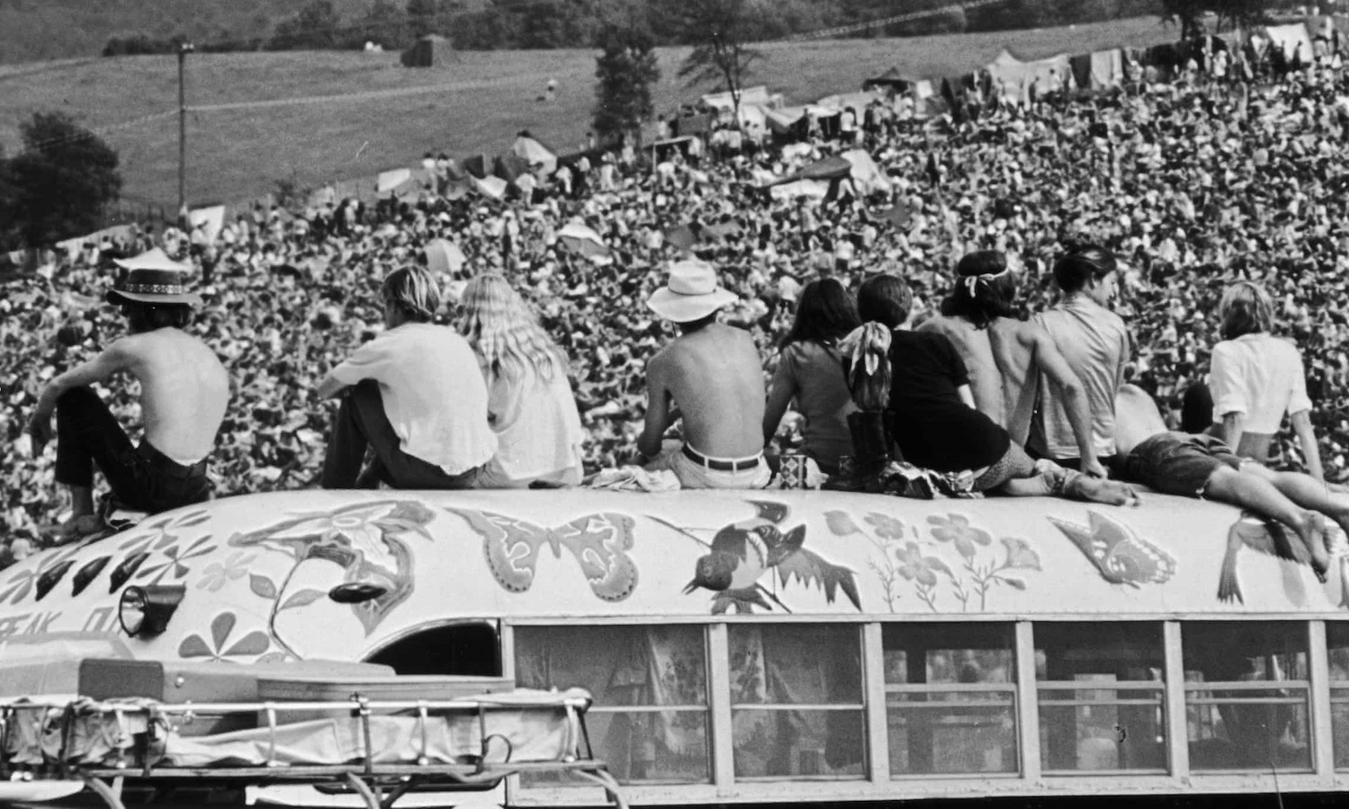
Baby Boom Generation
Born 1946–1964 (AGE 61-79)
Named for the Population Boom after WW2
Wild youth
Viet Nam War Protests
Summer of Love
Woodstock
Started concept of family meetings
Kids played outside without constant supervision
This Photo by Unknown Author is licensed under CC BY-NC-ND

Slide 6
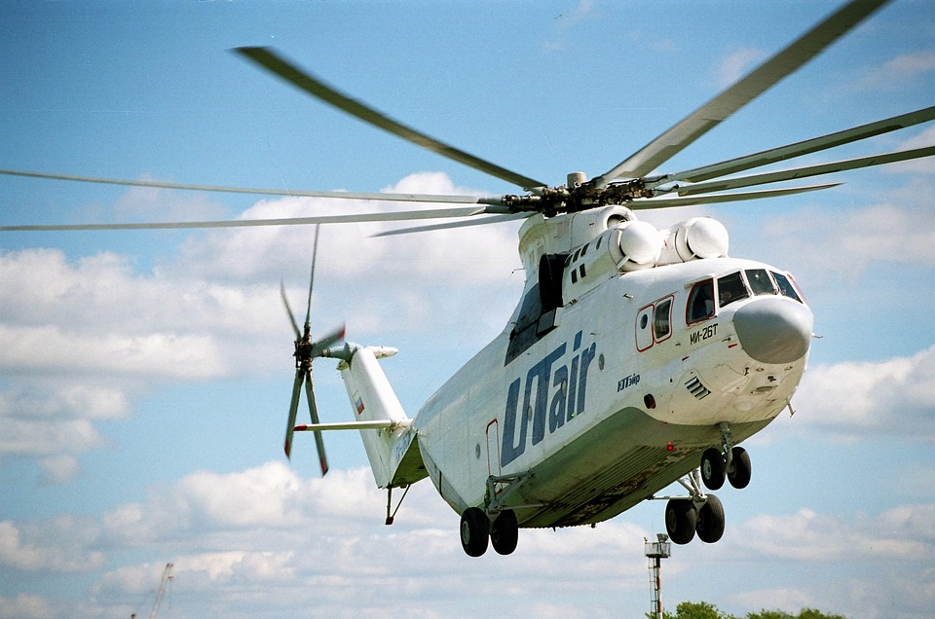
Generation X:
Born 1965–1980 (AGE 45 to 60)
Lived through the AIDS Epidemic
MTV
Rise of LGBTQ+ rights
Helicopter Parents
Far more involved with their children’s social and educational development
More structured activities

Slide 7
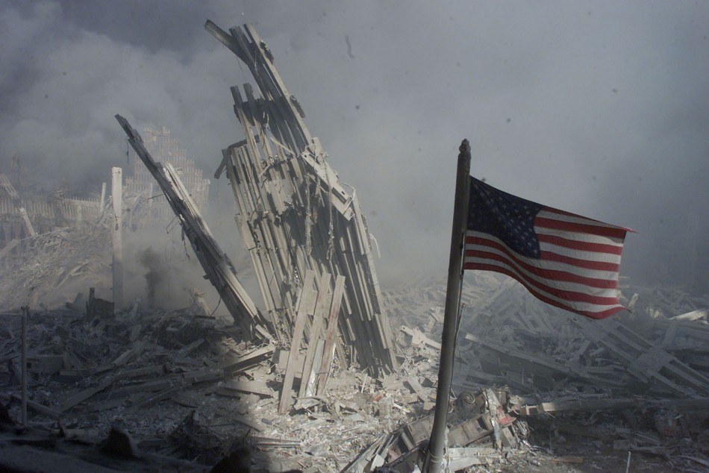
Millennial Generation or Generation Y
Born 1981–1996 (AGE 29-45)
LIVED through 9/11
AMAZON only sold books.
Lived through the transition to the internet
Community-oriented and environmentally conscious, traits being picked up by their children.
Encourage Children to be their selves
Genetic research and discovery of complex gender differences
There was support of gender non-conforming children
More tolerance and allowance of personal exploration
This Photo by Unknown Author is licensed under CC BY-NC-ND

Slide 8

Generation Z or iGen
Born 1997–2010 (AGE 15 to 28)
Constant Connection: phones, screens, and tablets
Environmentally conscious
Inclusive and accepting of others
Political awareness
Not yet of voting age

Slide 9

Generation Alpha
Born 2010-2024 (Age 1 to 15)
Social media was always there
Tech Savvy
Reduced Attention spans and fewer interpersonal connections
Some were born during covid
Likely to be in a single parent household
They may redefine education and the workforce
This Photo by Unknown Author is licensed under CC BY-NC-ND

Slide 10
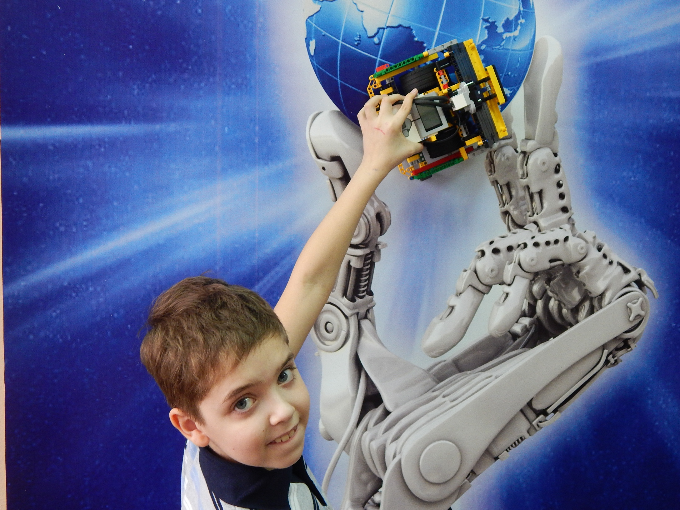
Generation Beta
Born 2025-2039 (Age 0 to -14) ?????
? Tech Savvy and socially conscious
? Priorities of adaptability, social consciousness, sustainability
? AI
? Digital connectivity
? Parents will guide them through life

Slide 11
Discussion
WHAT GENERATION DO YOU BELONG TO?
DO YOU AGREE WITH THE CHARACTERIZATION OF YOUR GENERATION?
DO YOU AGREE THAT YOUR VALUES HAVE BEEN SHAPED BY YOUR PERSONAL EXPERIENCES.
WHAT CHALLENGES DO YOU FACE IN ACCEPTING THE EXPERIENCES OF YOUNG PEOPLE?
HOW IMPORTANT IS EMPATHY IN WORKING WITH YOUTH OF GENERATION Z ?
HOW CAN YOU PUT ASIDE YOUR PREJUDICES SO AS NOT BEING JUDGEMENTAL.?

Slide 12

The Four Way Test
This Photo by Unknown Author is licensed under CC BY
How will the ”Four Way Test”
Help you in your quest to serve and inspire young people?

