Slide 1


Slide 2

HEART and Belonging
Notes:
For tonight's purposes and my discussion on belonging and membership I am often asked what the difference is between Inclusion and Belonging
Inclusion is an Action – so I was invited to a club to consider membership
Belonging is a feeling – do I fit into this club, am I comfortable welcomed and will I stay

Slide 3
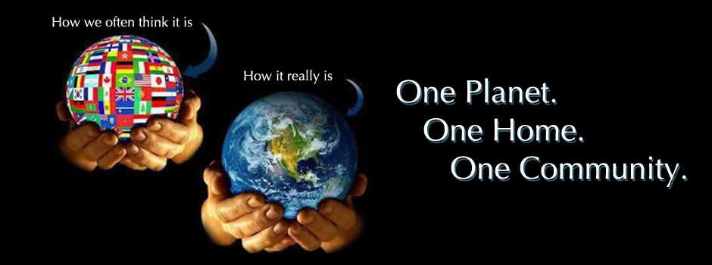
Humanity & Belonging
Humanity (we are human beings, we interact with one another, we want to belong, be accepted, feel kindness)
Notes:
"Humanity" refers to the shared qualities, struggles, and experiences that unite us as human beings, while
"Belonging" is about feeling accepted, understood, and valued in a community or group.
Together, they highlight the importance of connection—both to others and to the shared human experience.
When people feel seen and heard for who they are—no matter their background or story—they can experience the deep sense of belonging that is crucial for emotional and psychological well-being.
Belonging nurtures our shared humanity. Belonging often creates spaces where we can express our true selves, where differences are celebrated, and where people work together for mutual support.
This sense of belonging reinforces our shared human experience and reminds us that we are not isolated in our journeys.

Slide 4
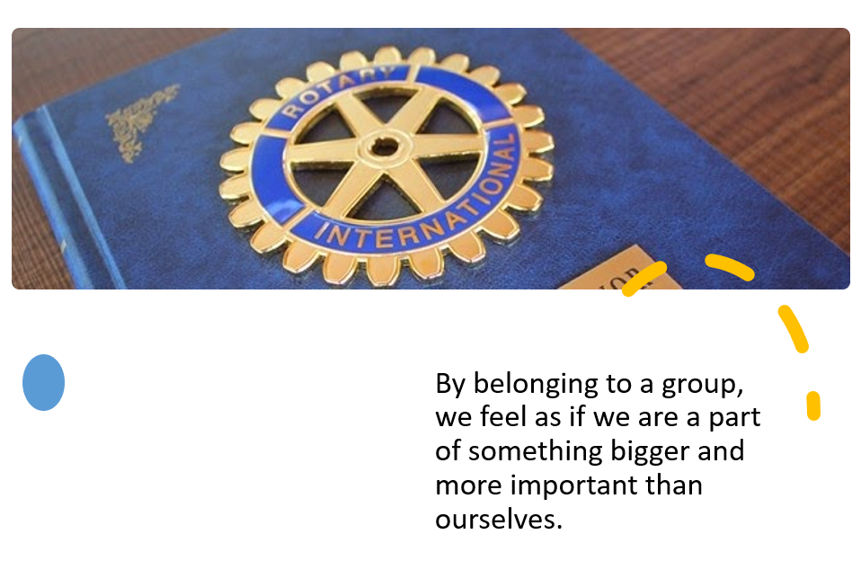
Empower & Belonging
Empower (we contribute our time and support our funding to enable lasting change locally and internationally.)
To know what they do matters.
Notes:
Making a connection between empowering individuals and fostering belonging is crucial for achieving RI’s organization's mission of service and creating lasting social change.
Rotary cultivates empowerment and Belonging by offering
1. Diversifying Leadership Opportunities…………. Ensuring that leadership roles and opportunities are accessible to members from all backgrounds—whether that’s through gender, age, cultural heritage, or professional background
Diverse leadership helps mirror the community and creates an even stronger bond among members.
2. Mentorship and Collaboration: Offering mentorship programs that empower younger or newer members while simultaneously reinforcing the sense of belonging within the group can build lasting relationships and ensure continuity in Rotary's work.
When members feel both empowered and that they belong, they are more likely to remain engaged, make lasting contributions, and feel personally fulfilled. The synergy between these two forces strengthens both the individual and the collective impact of Rotary’s service work.

Slide 5

Aspire & Belonging
Aspire (storytelling and promoting our brand of ‘service above self’ shows the world the impact a person can make when leading with you)
The sense of belongingness, also known as the need to belong, refers to a human emotional need to affiliate with and be accepted by members of a group.
True Belonging does not require you to change who you are it requires you to be who you are.
Notes:
In Rotary International, Aspire and Belonging are deeply connected. Members aspire to grow, lead, and serve, while at the same time, they find belonging in a community that shares their values and mission.
This dynamic allows for personal and collective growth, fostering a sense of purpose and community that keeps members engaged, motivated, and committed to Rotary’s work.
When members feel that they belong, their aspirations are more likely to be realized, and in achieving their aspirations, they help others feel that same sense of belonging.

Slide 6

Readiness & Belonging
Readiness (we are ‘people of action’…it is time we act within our clubs to strengthen who we are and the plan we will follow)
Notes:
Action planning that is inclusive, collaborative, and clear reinforces the sense of belonging and encourages sustained engagement.
Readiness and belonging are intertwined because effective action planning in Rotary is built on a foundation of connection, trust, and mutual respect.
When members feel they belong, they are more likely to be ready to engage in action, contribute their time, talents, and ideas, and support the club's goals.

Slide 7
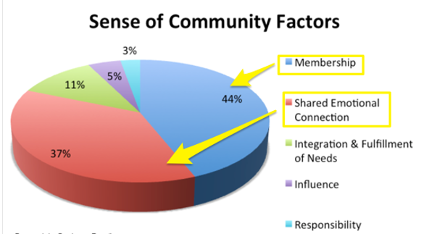
Together & Belonging
Together (in order for us to be successful, we need teamwork We need to engage all club members to participate in our efforts to adapt, further our reach, and create intentional service.)
Notes:
Rotary’s fundamental principle is “Service Above Self.” Members come together to make a difference in their communities and the world. Through this collective effort, the bonds between members are strengthened. The togetherness is not just about being physically present; it’s about working side by side toward common goals, whether it's eradicating polio, improving education, or addressing global health crises.
In Rotary, Together and Belonging work in harmony to create a strong, supportive, and active community. Members come together to make a difference, and through that collaboration, they develop a deep sense of belonging to the club and its mission.
The shared purpose of service, the inclusive and supportive environment, and the lasting friendships built within the club ensure that members not only contribute to Rotary’s goals but also feel genuinely valued and connected.
This combination of togetherness and belonging creates a powerful force for positive change, both within Rotary and in the communities they serve.

Slide 8
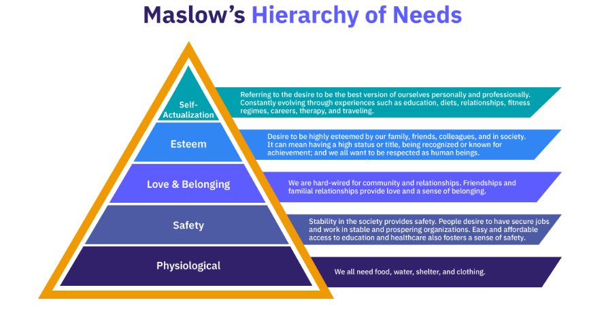
A sense of belonging is a basic human need, also defined in Maslow’s Hierarchy of Needs:
Notes:
So lets look at Maslow's hierarchy of needs
When people feel a sense of belonging, it significantly influences their esteem and self-actualization needs.
Feeling accepted and connected provides the emotional foundation that allows individuals to pursue more personal, aspirational goals.
Lets look at how the different levels of the hierarchy might manifest in Rotary:
Physiological Needs:
While Rotary is not directly focused on addressing basic survival needs, some of the projects Rotary supports—such as providing clean water, food, and healthcare to underserved communities—help meet physiological needs for those in need.
Safety Needs:
Rotary’s efforts in peace-building, public health, and disaster relief contribute to creating a safer environment for people worldwide. Rotarians who are part of these efforts can feel secure knowing they are part of an organization that promotes safety and stability.
Love and Belonging Needs:
Rotary clubs provide a sense of community, fellowship, and support. Members find a sense of belonging in a global network of like-minded individuals dedicated to service and positive change. This social connection can help members fulfill their emotional and social needs.
Esteem Needs:
Members of Rotary feel a sense of pride, respect, and recognition for the work they do in their communities and beyond. The leadership roles, recognition for achievements, and the esteem gained through Rotary's global impact help fulfill these esteem needs.
Self-Actualization:
Rotary allows members to grow, pursue their passions, and realize their potential through leadership opportunities, personal development, and involvement in meaningful service projects. The sense of purpose that comes from making a real difference aligns with the idea of self-actualization.

Slide 9

Belonging
The Key to Engagement
If an increase in feelings of club connection isn't enough to get you to buy into belonging, here's another interesting fact:
Belonging isn't just a key to DEI; it's also the key to club engagement.

Slide 10
Belonging – The Key to Engagement
Clubs with high levels of belonging also have higher retention rates.
Clubs also see improvement with respect to retention, intention to stay and measures of teamwork effectiveness
When people feel as though they’re accepted and part of something, they’re more willing to support one another and the goals of the organization.
Notes:
In Rotary, belonging is more than just a sense of inclusion—it’s the emotional connection and investment that members have in the organization’s mission and community.

Slide 11
Creating a culture of belonging centers around four principles:
Being seen:
Being recognized for who you are as well as being respected and rewarded for it.
Feeling connected:
Having authentic, positive interactions with your club members and community.
Feeling supported:
Feeling that your peers can give you what you need to complete your community work and live a full life.
Feeling proud:
You feel that your clubs' values align with your own, and you feel proud to come to club meetings with an aligned purpose and vision.
Notes:
Belonging is indeed the key to engagement. When individuals feel that they belong to a group, they become more committed, motivated, and passionate about contributing their time, skills, and resources.
In Rotary, fostering a sense of belonging through meaningful connections, inclusivity, recognition, and empowerment can significantly boost member engagement and drive the organization’s impact.
The stronger the sense of belonging, the more deeply members will engage, ensuring Rotary’s continued success and growth.
These four principles form the foundation of a truly inclusive and meaningful experience within our clubs.
By embedding them into the culture of your Rotary club, you can foster a sense of community, boost retention, and create a space where everyone feels valued and motivated.
Be Intentional: Be intentional about creating opportunities for members to connect and engage based on the principles of belonging.
By focusing on being seen, feeling connected, feeling supported, and feeling proud, Rotary clubs can cultivate a stronger sense of belonging that leads to increased engagement and membership retention.
These principles create an environment where members are emotionally invested, feel valued, and are motivated to stay committed to Rotary's mission of service above self.

